Slide 1





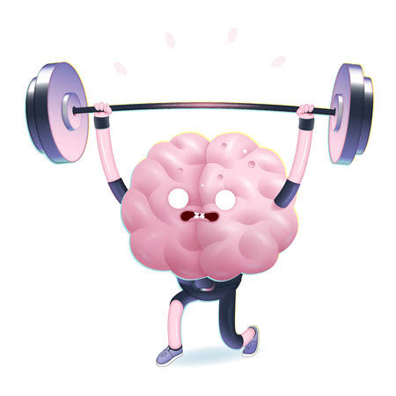
SPORTSTER
Group Members:
Muhammad Fahad Imdad (S21CSC01)
Bilal Ahmed (S21CSC10)
Huzaifa Mustafa (F20CSC27)
Supervisor:
Sir Ateeque Rahman
Co- Supervisor:
Miss Sidra Nasir
Department of Computer Science
Faculty of Information and Technology

Slide 2
Overview
Background
Introduction
Motivation
Problem Statement
Scope of the Project
Project Objectives
Features
Comparative Analysis
Customer Survey
Owner Survey
Collaboration
USP
User Interface
Tools and Languages
Gantt Chart
Division of role
Conclusion
References

Slide 3
Background
American Heart Association (AHA): Their research indicates a higher risk of heart disease, stroke, and other cardiovascular conditions among individuals with a sedentary lifestyle.
World Health Organization (WHO): The WHO highlights the global health impact of physical inactivity, identifying it as the fourth leading risk factor for global mortality.
Mayo Clinic: Mayo Clinic suggests that extended periods of sitting contribute to obesity, increased blood pressure, high blood sugar, and abnormal cholesterol levels.
National Institute on Aging (NIA): The NIA emphasizes the link between sedentary behavior and an increased risk of chronic conditions, including diabetes and certain cancers.
Harvard T.H. Chan School of Public Health: Harvard's School of Public Health research suggests that regular physical activity helps regulate blood sugar levels and reduces the risk of insulin resistance.

Slide 4
Introduction
A physically active lifestyle offers numerous benefits and improves overall well-being compared to a sedentary lifestyle, which involves prolonged periods of sitting and limited physical activity.
Benefits and Impact:
Improved Cardiovascular Health
Enhanced Muscular Strength
Weight Management
Better Mental Health
Increased Energy Levels
Improved Sleep Quality
Reduced Risk of Chronic Diseases
Regular exercise and physical activity are essential for maintaining optimal health, reducing the risk of chronic diseases, and enhancing quality of life.

Slide 5
Motivation
Improved Health and Well-being
Increased Energy and Vitality
Enhanced Mood and Mental Health
Boosted Self-confidence
Better Sleep Quality
Stress Relief
Long-term Health Benefits
Setting a Positive Example
Enjoyment and Fun
Sense of Achievement

Slide 6
Problem Statement
Sedentary lifestyle prevalent in contemporary digital era.
Conveniences of technology contribute to reduced physical activity.
Health risks: Cardiovascular diseases, obesity, musculoskeletal disorders, mental health issues, metabolic syndrome, chronic pain, reduced immune function, sleep disorders, decreased lifespan.
Challenge:
Motivating sedentary individuals to engage in physical activities.
Lack of physical activity leading to decline in overall health and well-being.
Need for interventions to promote physical activity and combat sedentary lifestyle.

Slide 7
Scope of Project
Design and develop a user-friendly mobile application.
User Interface Design: Create an intuitive interface for easy navigation and booking of sports grounds, fitness facilities, and coaching facilities.
Backend Development: Develop a robust backend system to manage user data, booking transactions, and facility listings.
GPS Integration: Implement GPS functionality to assist users in locating nearby sports grounds and fitness facilities.
Payment Integration: Incorporate a secure payment method for booking transactions.
User Feedback System: Establish a feedback mechanism for users to provide reviews and ratings for facilities.

Slide 8
Project Objectives
The proposed idea is to develop an application called Sportster that aims to provide booking service of all nearby Sports arena and fitness centers.
The deliverables of the Sportster application will include:
Booking sports services nearby
Improved coordination between users and customers regarding availability of slots.
Tournaments Organized by Sports Arenas
Social circle of friends making plans together (Mood Feature)
Future Goals
Providing Coaching and home training classes to individuals (Coaching Service)
Providing customers with sports accessories at best possible prices (Store)

Slide 9
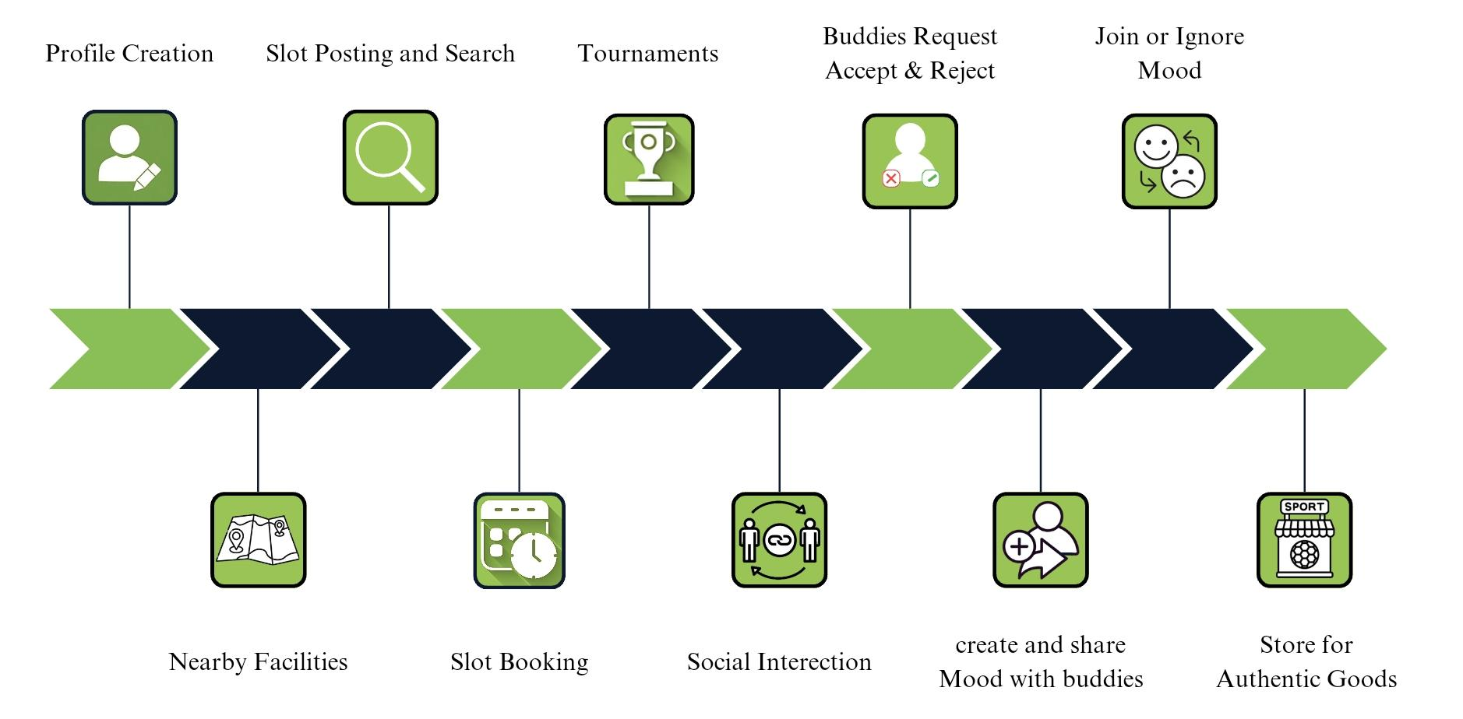
Features

Slide 10
Comparative Analysis
Feature | Our App | Malaeb | Playspots | Wefit
Efficient Booking of Sports Arena | Yes | Yes | Yes | No
Sports coaching | Yes | Yes | Yes | No
Efficient Booking of nearby Gyms | Yes | No | No | Yes
Gym Training service | Yes | No | No | Yes
Home Fitness Services | Yes | No | No | No
Friend Social Circle | Yes | Yes | Yes | Yes

Slide 11
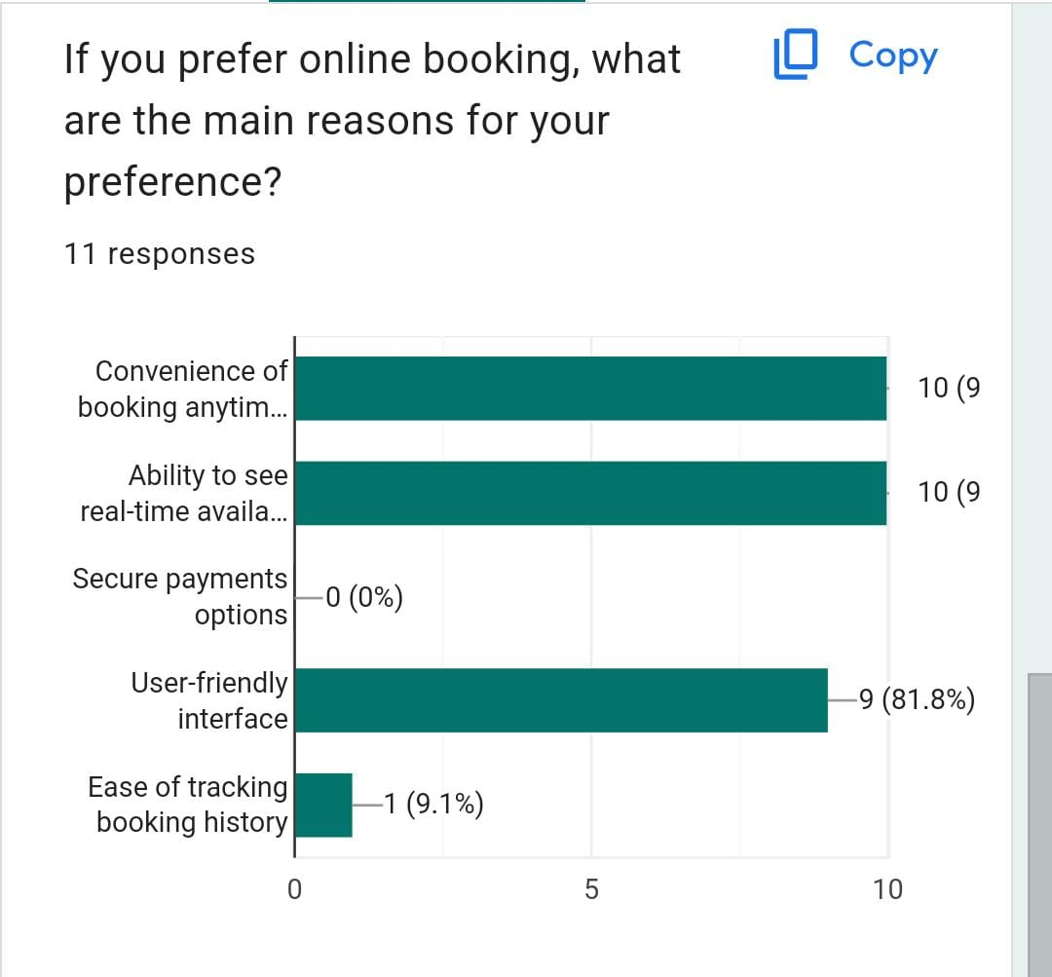
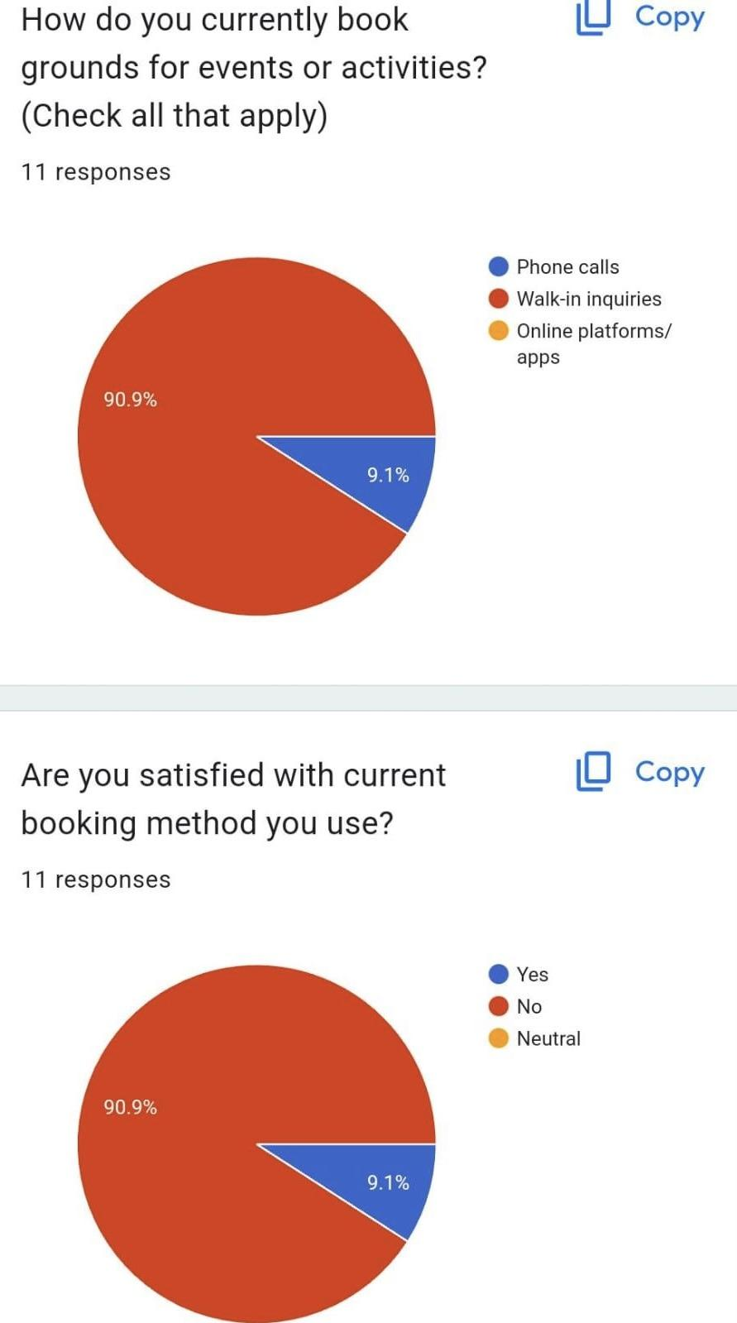
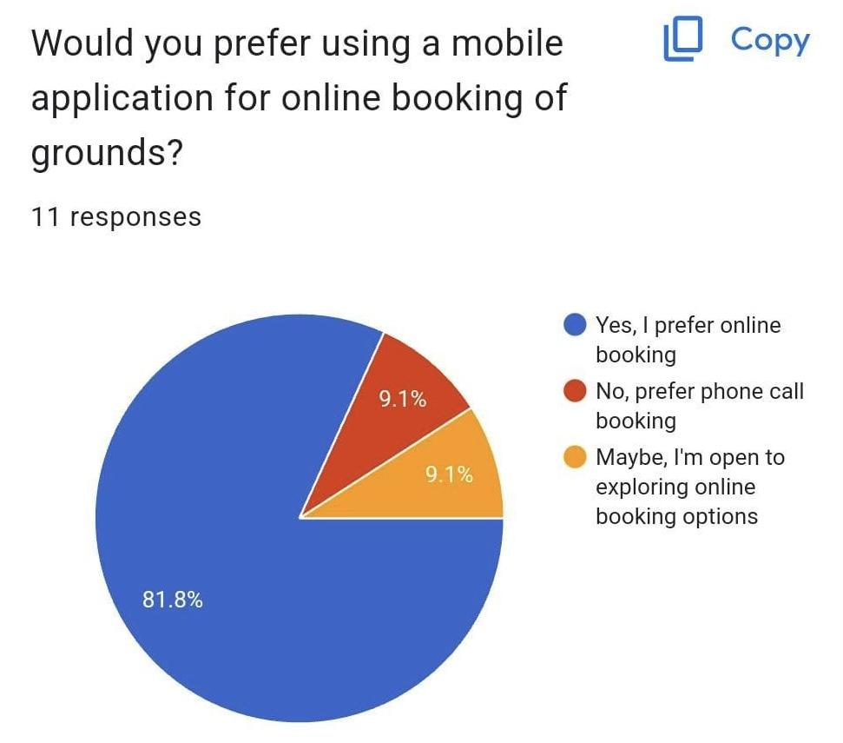
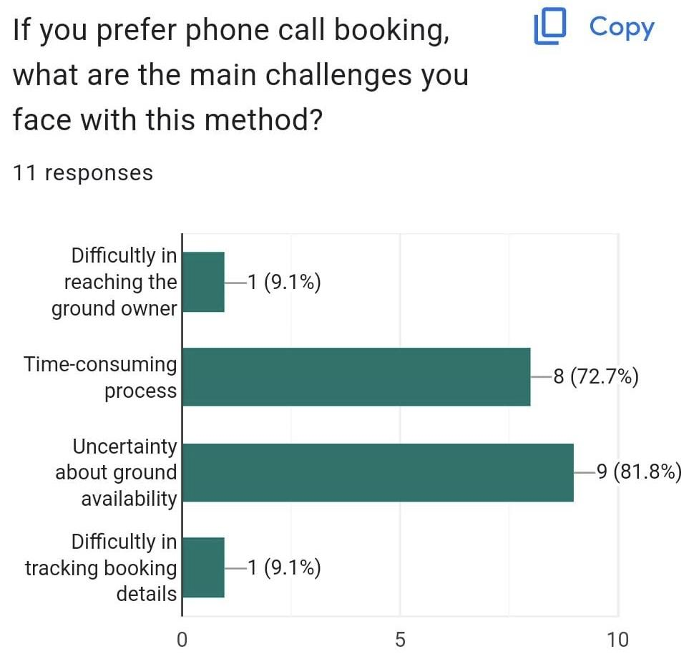
Customer Survey

Slide 12
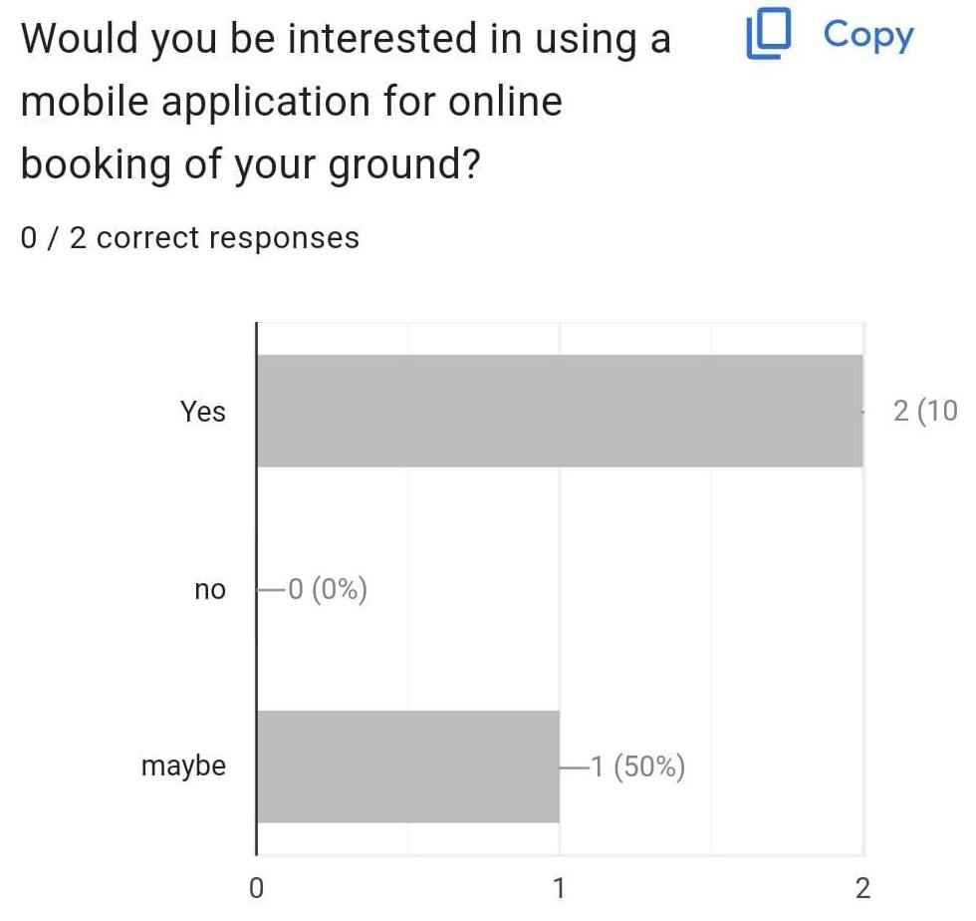
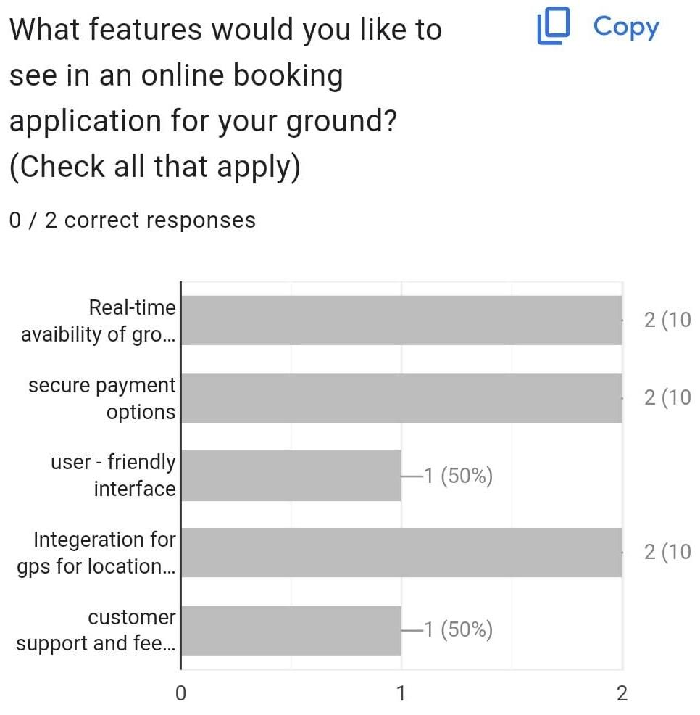
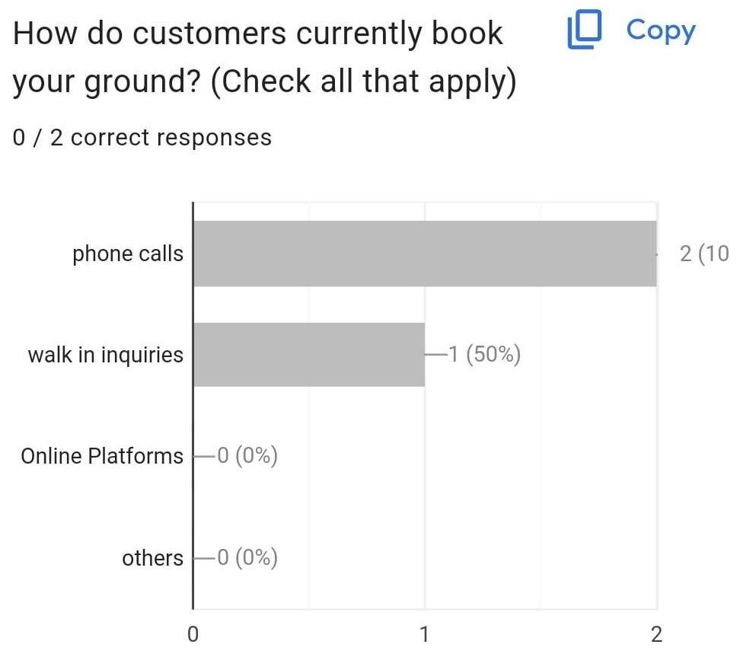
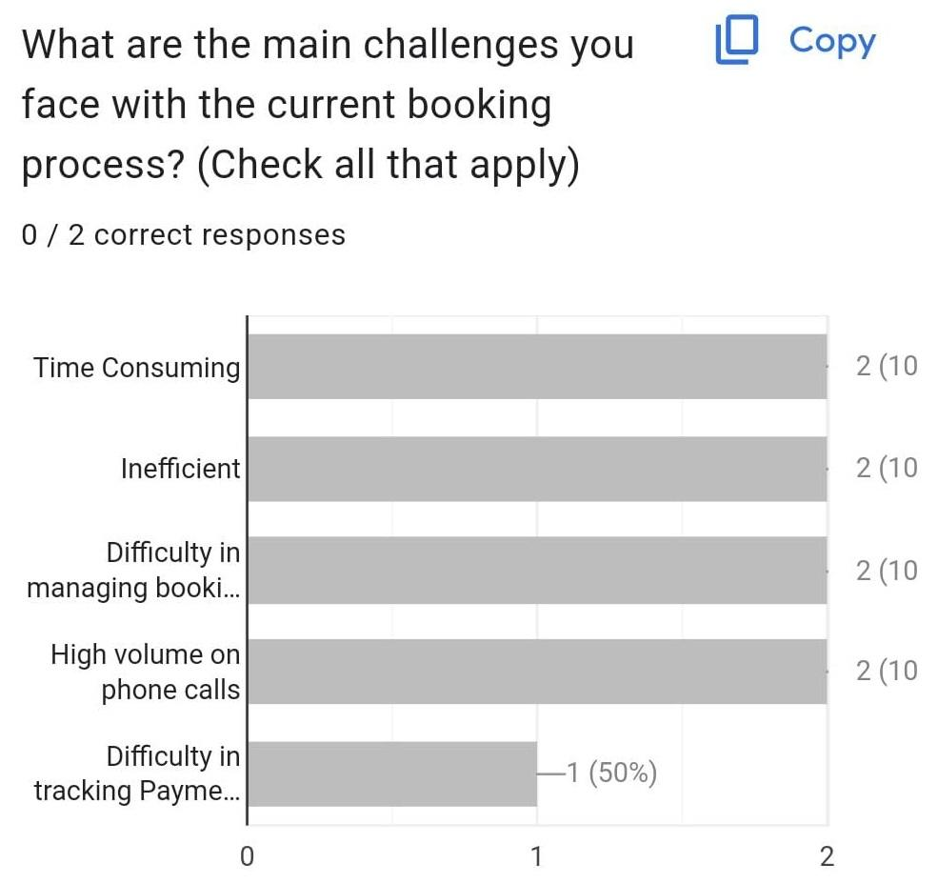
Owner Survey

Slide 13
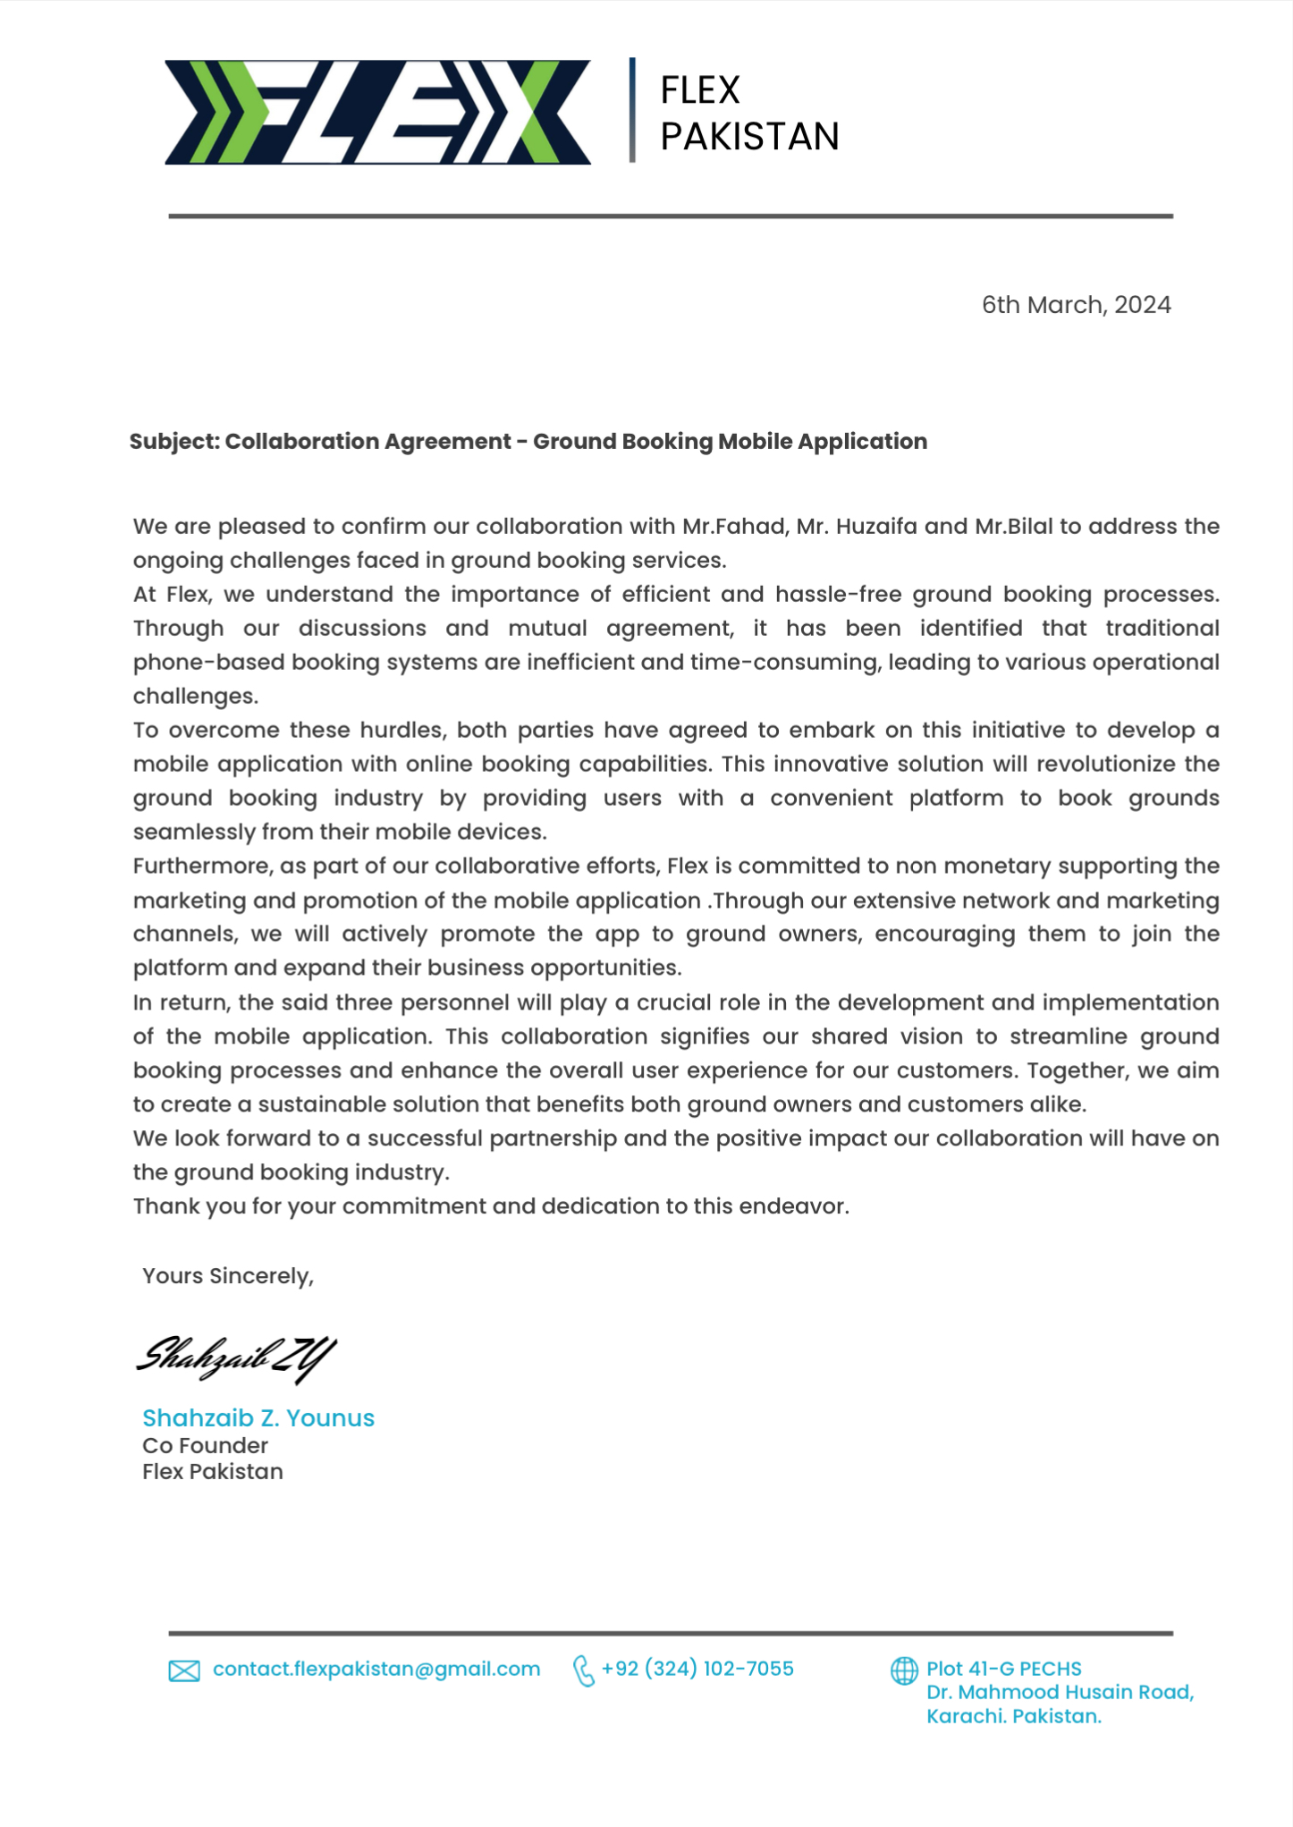
Collaboration With FLEX

Slide 14


USP

Slide 15
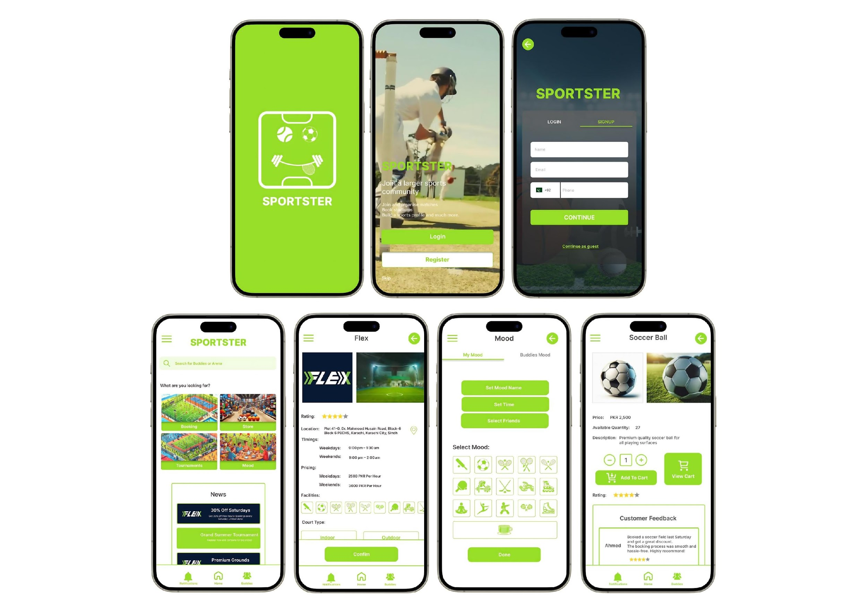
User Interface

Slide 16
Tools and Languages
Mobile Application(Android & IOS):
Frontend:
Java
Backend:
Java Firebase
Database:
Firebase Firestore
APIs:
Google Maps API
Firebase API
OTP less

Slide 17
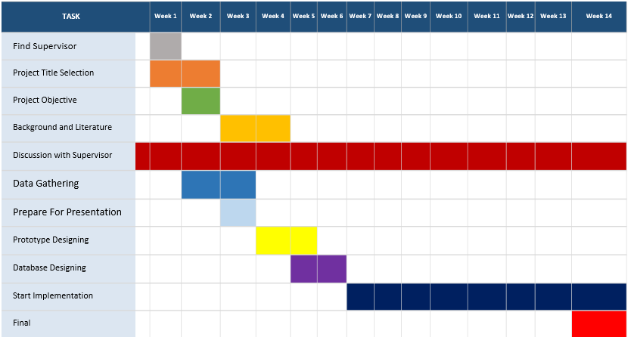
Gantt Chart

Slide 18
Division of Role
Roles | Muhammad Fahad Imdad | Bilal Ahmed | Huzaifa Mustafa
Designer | ✅ | ✅ | ✅
Developer | ✅ | ✅
Tester | ✅ |  | ✅
Data Analyst |  | ✅ | ✅

Slide 19
Conclusion

Slide 20

References
Flex Pakistan
https://www.facebook.com/flexpakistan?mibextid=ZbWKwL

Slide 21
Q/A Session

